Slide 1
Anomaly detection using deep learning to measure quality of Large Datasets
-Sridhar Alla , Syed Nasar

Slide 2

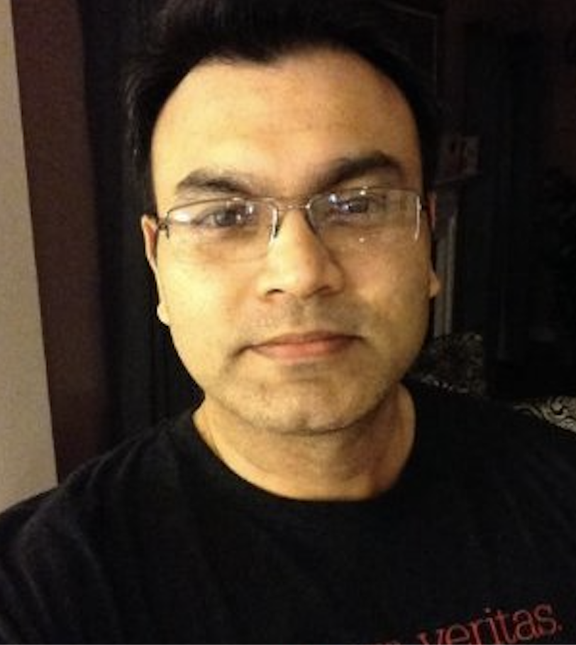
Speakers
Sridhar Alla is Co-founder & CTO at BlueWhale, a AI+BigData solution provider.
Author of Beginning Anomaly Detection Using Python Deep Learning – Apress 2019
Syed Nasar, Solutions Architect at Cloudera.
Cloudera ML Specialization Team
Founder of Nashville Artificial Intelligence Society.
@techmazed

Slide 3
Agenda
Detecting Anomalies in Datasets and ETL processes
Thinking Data Quality
Types of anomalies
Challenges in Anomaly Detection
Demo - A simple anomaly detection
Machine Learning Models
Deep Learning Models

Slide 4
Detecting Anomalies for Data Quality
Anomalies in Datasets and ETL processes

Slide 5
Thinking Data Quality
Data quality issues in big data space
Six Vs:
Volume
Velocity
Variety
Veracity
Variability
Value
DQAF include
Completeness
Validity
Timeliness
Consistency
Integrity
Source: Measuring Data Quality for Ongoing Improvement: A Data Quality Assessment Framework, by Laura Sebastian-Coleman. Published by Morgan Kaufmann Publishers, Burlington, Mass. ISBN 9780123970336. Copyright 2013, Elsevier BV.
Notes:
DQAF - Data Quality Assessment Framework

Slide 6
Types of anomalies
Anomalies can be classified into following categories
Point Anomalies
If one object can be observed against other objects as anomaly, it is a point anomaly. This is the simplest anomaly category and a lot of researches include them.
Contextual Anomalies
If object is anomalous in some defined context. Only in this case it is contextual anomaly *also known as conditional anomaly
Collective Anomalies
If some linked objects can be observed against other objects as anomaly. Individual object can’t be anomalous in this case, only collection of objects.

Slide 7
Data quality issues
A few examples of data quality issues
Dataset level
Format, delimiters, metadata
Column level
Cardinality
Record level
Missing, duplicates, extreme, range, business rule, derived columns
Message level
Metadata, Malformed, Validating source
ETL Level
Process failure, transformation failures

Slide 8
Representing Data Quality
How to define and capture data quality aspects
Types of metrics
The ratio of data to errors
Number of empty values
Data transformation error rates
Amounts of dark data

Slide 9
Common methods for evaluating data quality
Data quality related algorithms
Dixon's Test - assumes normal distrib.
Rosner's Test - assumes normal distrib.; records > 25
Grubb's Test - univariate dataset ; normal distrib.
Regression analysis
Autoregressive integrated moving average (ARIMA) - time series; streams
Various statistical control charting - individuals, moving range, moving average, exponentially weighted moving average, etc.
Various non-parametric approaches - kernel function based, histogram based
Notes:
Rosner's test is appropriate only when the data, excluding the suspected outliers, are approximately normally distributed, and when the sample size is greater than or equal to 25.

Slide 10
Challenges
Why is it a difficult problem
Avoid alert black-holes
Option one is to generate alerts, and option two is to record events for later analysis but don’t alert on them.
Anomalies are not always rare.
A naive approach to alerting on anomalies is almost certain to cause a lot of noise.
Getting labels is a challenge
Minimizing false positives
No general purpose approach
Flavors vary from heuristics, statistics to Machine Learning to Deep Learning

Slide 11
DEMO
A simple approach to Anomaly Detection
with
Cloudera Data Science Workbench (CDSW)

Slide 12
TDDA
Test Driven Data Analysis
TDDA is a methodology and software for improving quality for improving robustness of analytic processes
One can repurpose TDDA's data verification capabilities as an anomaly detection framework

Slide 13
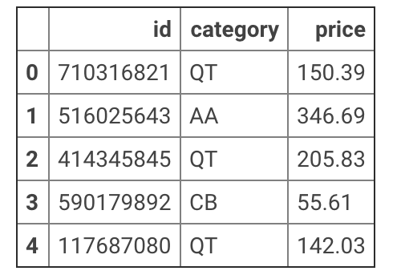
Dataset in the example
TDDA example
Price field
Range of values accepted?
Datatype?
Permitted null values?
Duplicates allowed?
Category field
Accepted categories?
Format of the category?

Slide 14
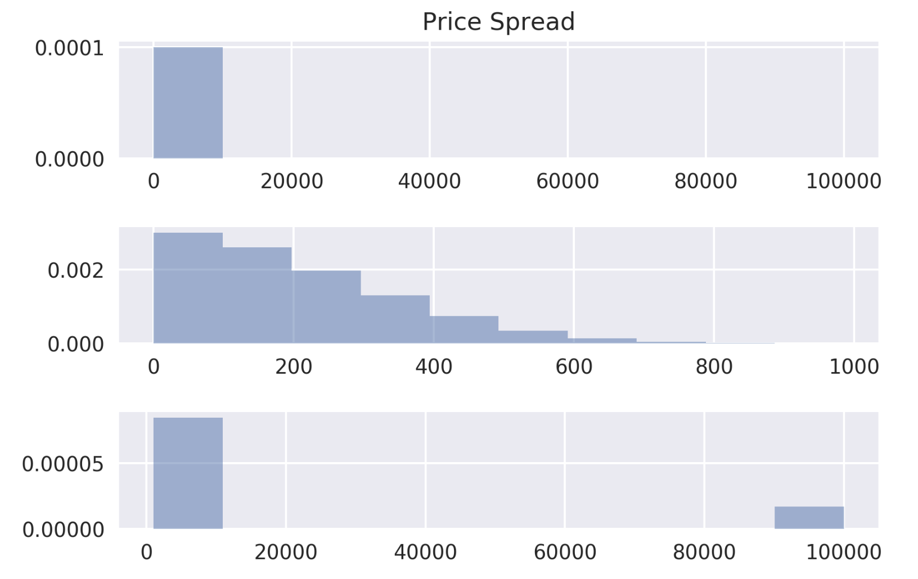
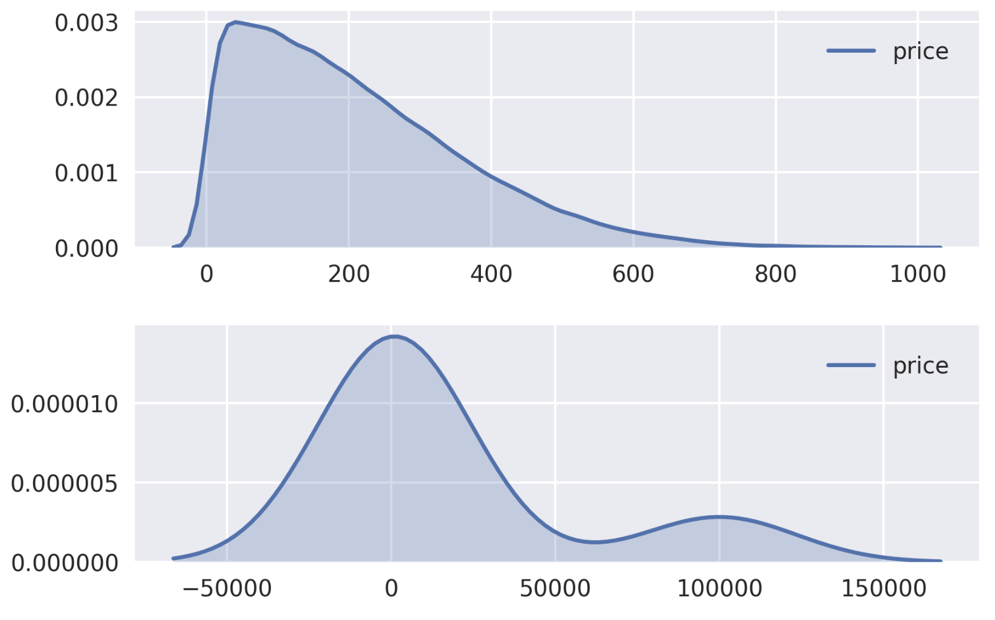
Characteristics of the Price attribute
Left skewness
Large tail
Non-normally distributed

Slide 15
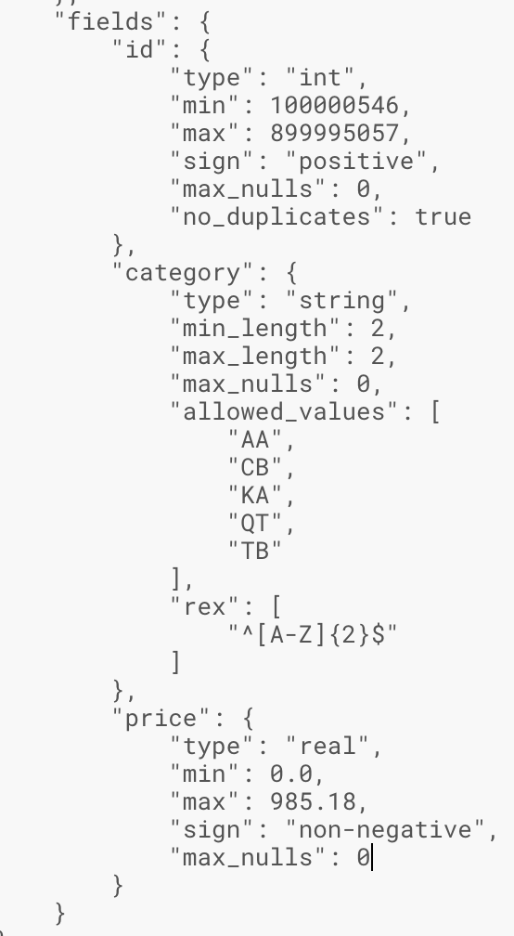
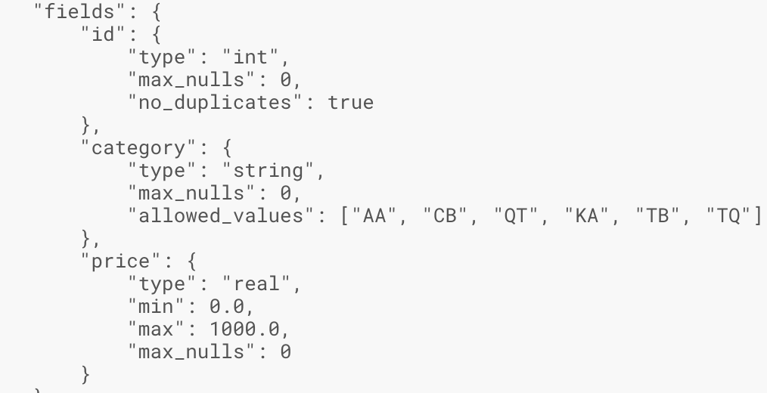
TDDA rules manual & automated rules
Handcrafted Rules
Discovered Rules

Slide 16
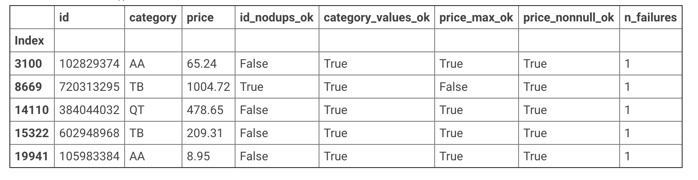
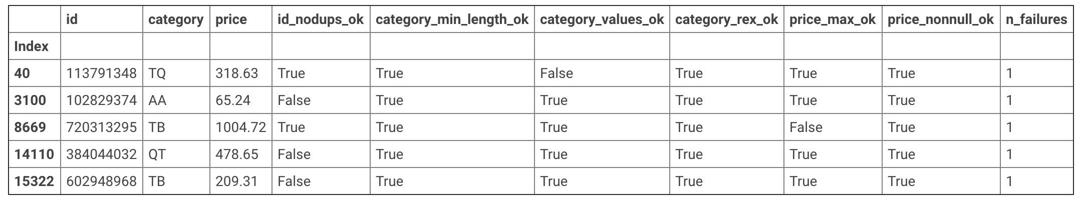
Detected items upon applying manual & automated rules
Output of Handcrafted Rules
Output of Discovered Rules

Slide 17
Machine Learning and Deep Learning techniques

Slide 18
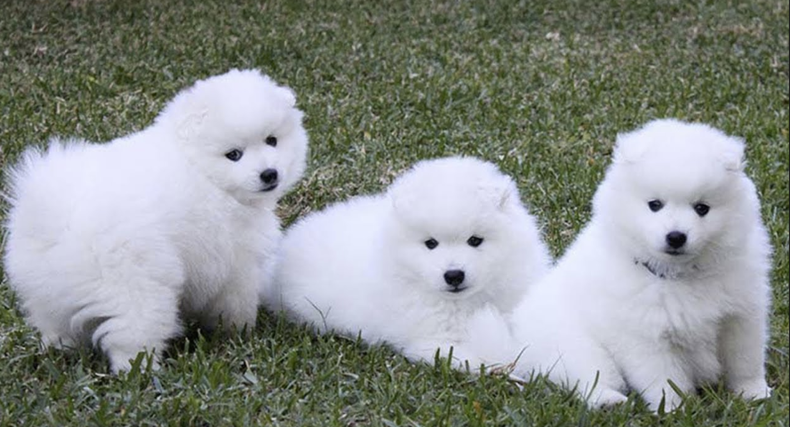
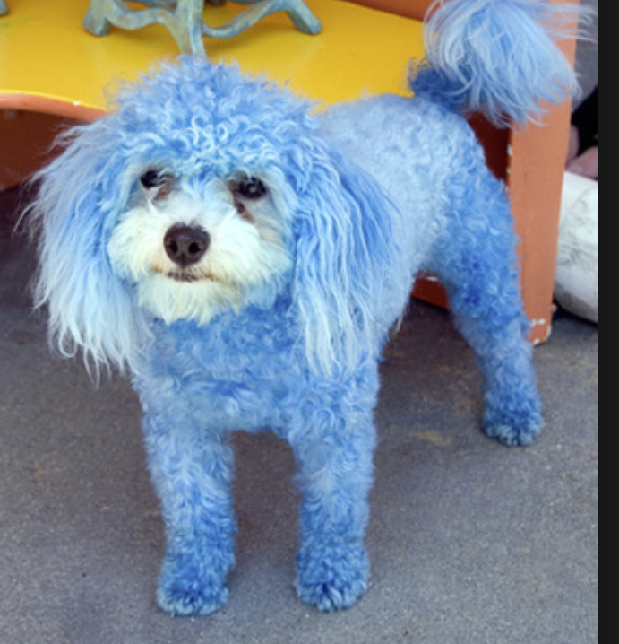
Anomaly Detection
D -Given Data Set consisting of points d1,d2…..dn
N- Normal Data points= d1,d4,……dn-1
A -Abnormal/Anomaly Data points = d2,d3….dn
How do we find A from D given N (labeled or unlabeled)

Slide 19
Machine Learning Algorithms
Isolation Forest – an unsupervised learning algorithm that is good for high-dimensional data. After randomly selecting a feature, it picks a random value between the selected feature's maximum and minimum values to 'isolate' observations.
One-Class Support Vector Machine – Depending on the implementation, it is an unsupervised or semi-supervised learning algorithm that is also suited for high-dimensional data. Can be applied to novelty detection, the classification of new data as outlier or normal after training on normal data only.
Mahalanobis distance – Measures distance relative to the centroid (intersection of all the variables).

Slide 20
Isolation Forest
Recursively partitions the data using a tree structure.
The distance from the node to the root can be used as a measure of normality.
Following that premise, when a collection of trees produce noticeably short paths for a certain data point, it is much more likely to be an anomaly.
In general, anomalies tend to have the shortest path length because less partitions are needed to isolate them. Meanwhile, normal data requires more partitions to become isolated, hence they have longer path lengths to the root.

Slide 21
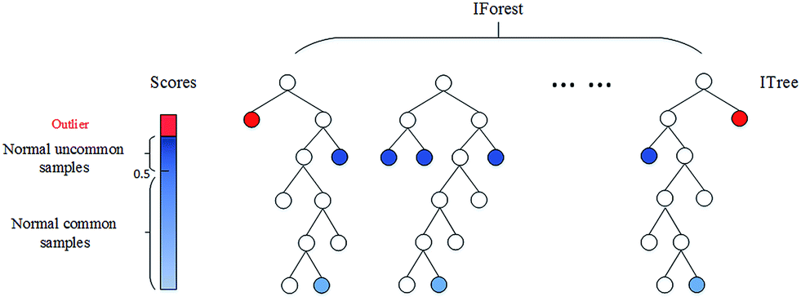
Isolation Forest
From this graph of an isolation forest, the general trend of anomalous data being closer to the root node can be observed.
Image credits: https://pubs.rsc.org/en/Image/Get?imageInfo.ImageType=GA&imageInfo.ImageIdentifier.ManuscriptID=C6AY01574C

Slide 22
One-Class SVM
Support vector machine model adapted to train on only one class, which in this case is the normal class.
After being trained only on normal data, the SVM can be used for the task of novelty detection to classify a new data point as normal or as an anomaly.
Training is about learning the frontier. Any points within the space enclosed by the frontier can be considered normal, while points that lie outside that space can be stated to be anomalous.

Slide 23
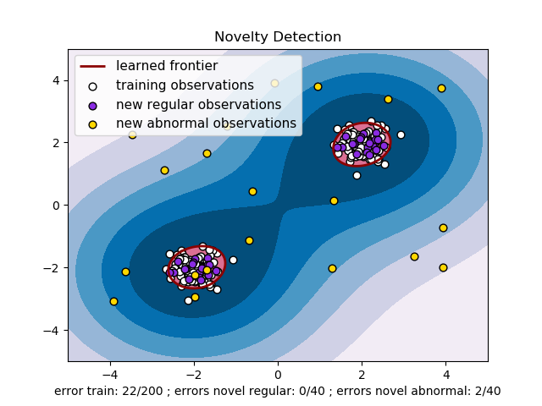
One-Class SVM
From this graph, the learned frontier boundaries of the one-class SVM can be observed. With the frontiers approximating the training data set, predictions of new data points either lie inside or outisde the boundary.

Slide 24
Mahalanobis Distance Ranked Algorithms
Mahalanobis distance is the distance between a data point and the centroid, the point where the means from all variables intersect.
After being trained only on normal data, the SVM can be used for the task of novelty detection to classify a new data point as normal or as an anomaly.
Training is about learning the frontier. Any points within the space enclosed by the frontier can be considered normal, while points that lie outside that space can be stated to be anomalous.

Slide 25
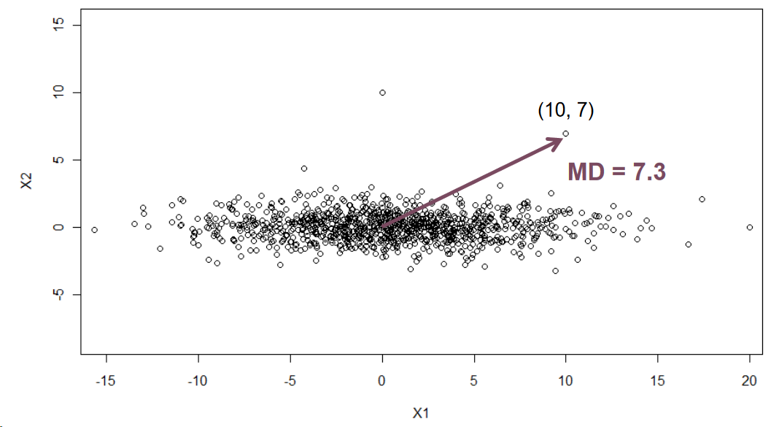
Mahalanobis Distance Ranked Algorithms
Calculation of the Mahalanobis distance is shown here in the graph. In two dimensions, it is simply the Euclidean distance between a given point and the centroid of the distribution. This same concept can be extended to multiple dimensions.

Slide 26
Deep Learning techniques
Autoencoders – Commonly used in semi-supervised learning, and is the core structure for unsupervised deep learning algorithms. Compresses the training data and learns to reconstruct the original data from this encoded representation. Variations known as denoising autoencoders and variational autoencoders can also be applied to anomaly detection.
LSTM / RNNs – For any data involving sequences or a time-series, LSTMs and RNNs are ideal. Can be built following an autoencoder architecture to allow for unsupervised anomaly detection.
Temporal Convolutional Network – A relatively new architecture that shows great potential in applications to problems involving sequential data. Can be used to detect anomalies in image data.
Boltzmann Machines – Several types of boltzmann machines including restricted boltzmann machines, deep boltzmann machines and deep belief networks can all be applied to anomaly detection.

Slide 27
Autoencoders
Learns efficient data encodings in an unsupervised manner. Essentially compresses the input data and decompresses it in an attempt to reconstruct the data as accurately as possible.
There are a variety of approaches to anomaly detection with autoencoders. One example would be a semi-supervised approach to novelty detection in which the model is trained only on normal data. When generating predictions on new points, normal data would be classified based on low reconstruction errors. On the other hand, anomalies would result in high reconstruction errors.
In unsupervised anomaly detection using a variation autoencoder for example, anomalies would be predicted based on an anomaly score calculated from the probability of seeing such a data point x on a probability distribution p(x).
For denoising autoencoders, they can be trained on noisy samples given the corresponding noiseless sample as the output. This way, anomalies as well as the channels causing the error can clearly be identified.

Slide 28
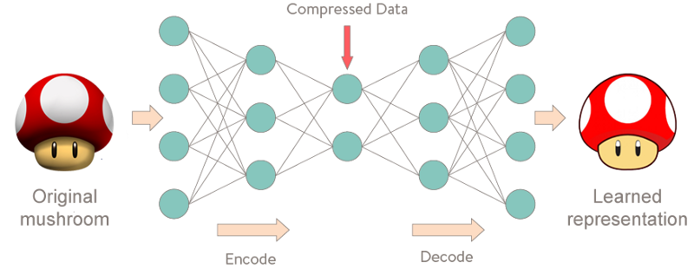
Autoencoders
Essentially, the model compresses the original data down in the encoder stage and attempts to reconstruct the original data as accurately as possible in the decoder stage.

Slide 29
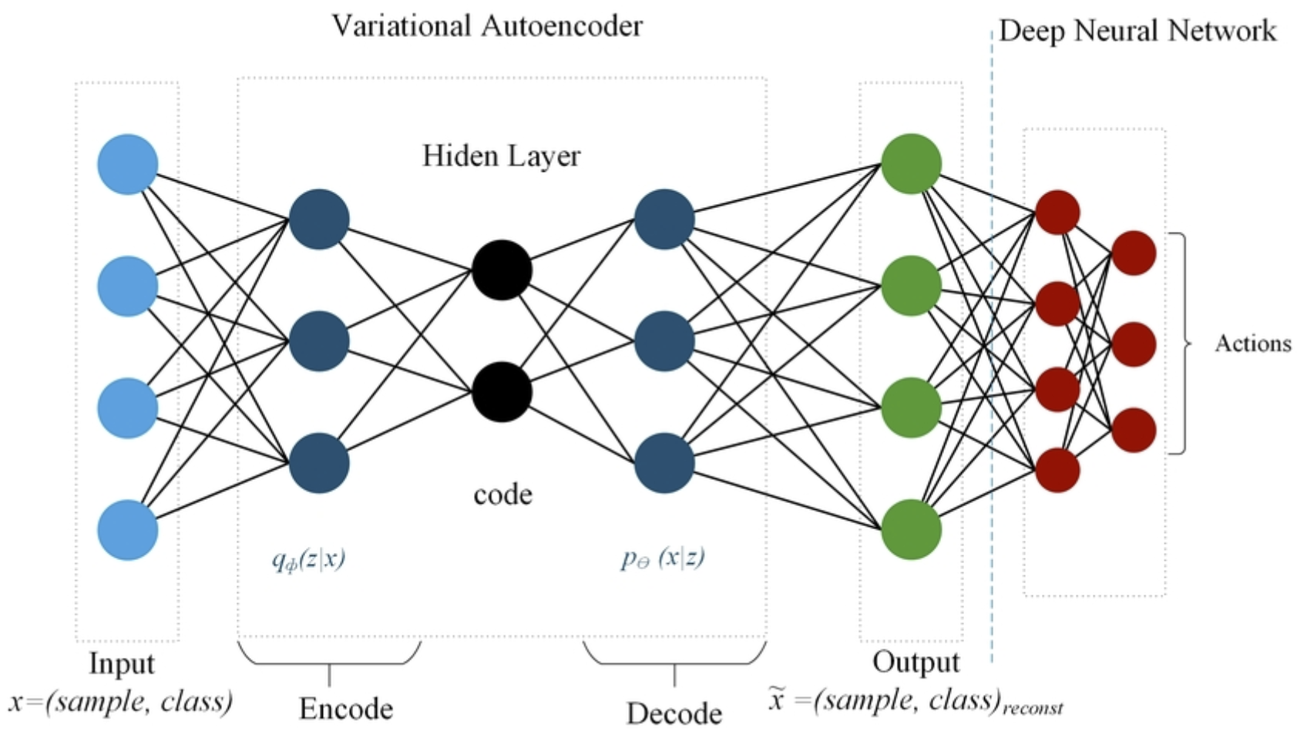
Variational Autoencoders
Instead of taking the latent vector(encoded/compressed data), take a sample of the distribution (mean & standard deviations).

Slide 30
LSTMs / RNNs
An LSTM is a type of RNN that can be used in time-series based anomaly detection. Essentially, an LSTM would train on time-series data and attempt to predict future time-steps. If there is a high error in the prediction, then it is likely to be an anomaly.
LSTMs or other RNN based models can be integrated into an autoencoder style architecture to perform unsupervised anomaly detection. The option also exists to pair an LSTM with another type of network such as a CNN. In this case, the CNN would act as the encoder, and the LSTM as the decoder.
While RNNs themselves can be used for anomaly detection, the LSTM offers better performance for many tasks.

Slide 31

LSTMs / RNNs
Unfolded RNN network. S represents the hidden state at time t, x is the input at time t, and o is output at time t.

Slide 32
Temporal Convolutional Network
Encoder-decoder temporal convolutional networks and dilated temporal convolutional networks (based on Google's Wavenet) are two examples of architectures involving temporal (one dimensional) convolutions.
Dilated TCNs train significantly faster than LSTMs because they can take advantage of parallel computing on the GPU. Additionally, the dilated TCN can be applied to problems involving time-series, offering significantly improved performance compared to the LSTM in some cases.

Slide 33
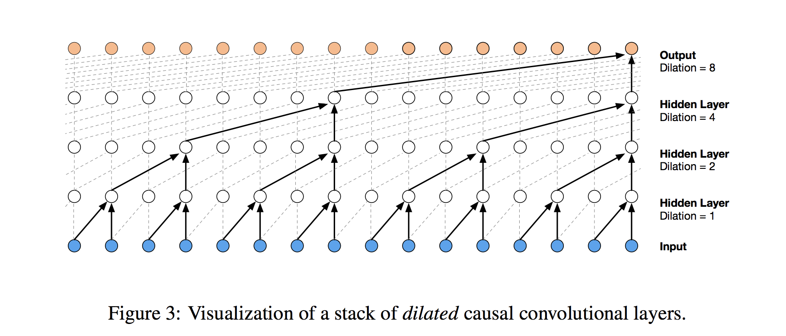
Temporal Convolutional Network
The dilated temporal convolutional network is named so because of the dilation involved within its layers, as seen in the graph above.

Slide 34
Boltzmann Machines
A basic restricted Boltzmann machine consists of a visible layer and a hidden layer. Both layers can either be binary or have the visible layer be Gaussian and the hidden layer be Bernoulli.
The free energy function can be derived from the RBM's energy function. The higher the free energy of some x, the higher the chance that x is an anomaly. Essentially, the RBM is stochastic, meaning it represents the data it trained on through a probability distribution. Anomalies would be detected by low probability scores, which are marked by high free energy by the free energy function.
A deep boltzmann machine is similar to an RBM, but is an undirected network and has multiple hidden layers. Since the DBM is also a probablistic model, it would detect anomalies in a similar fashion to the RBM.
Deep belief networks (DBN) are a generative, stochastic model that is comprised of stacks of RBMs.

Slide 35
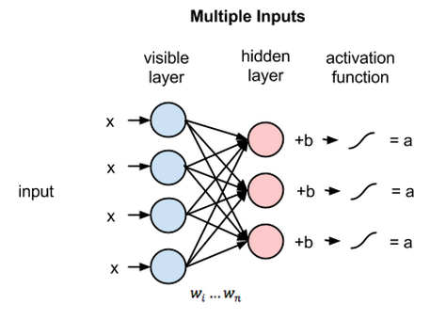
Boltzmann Machines
A restricted Boltzmann machine. The RBM is also generative, meaning it can generate new samples from what it has learned during the training process. By reversing the flow of data to start at the hidden layer and end at the visible layer, the RBM can generate reconstructions of the original input.

Slide 36
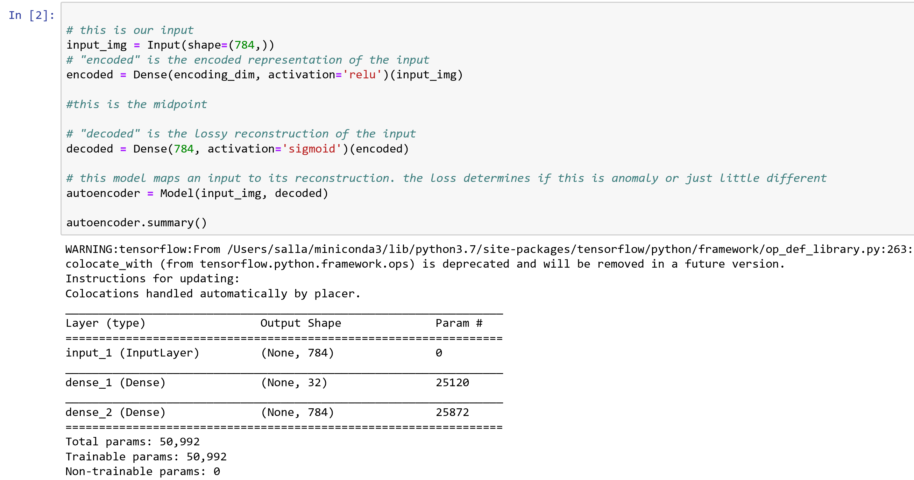
Autoencoder

Slide 37
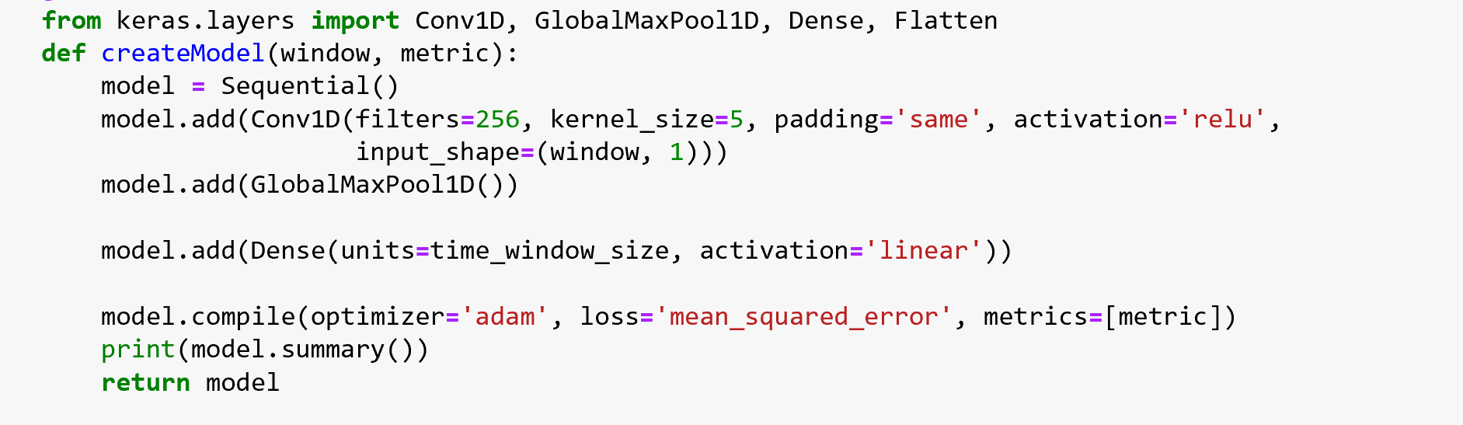
1 Dimensional CNN

Slide 38
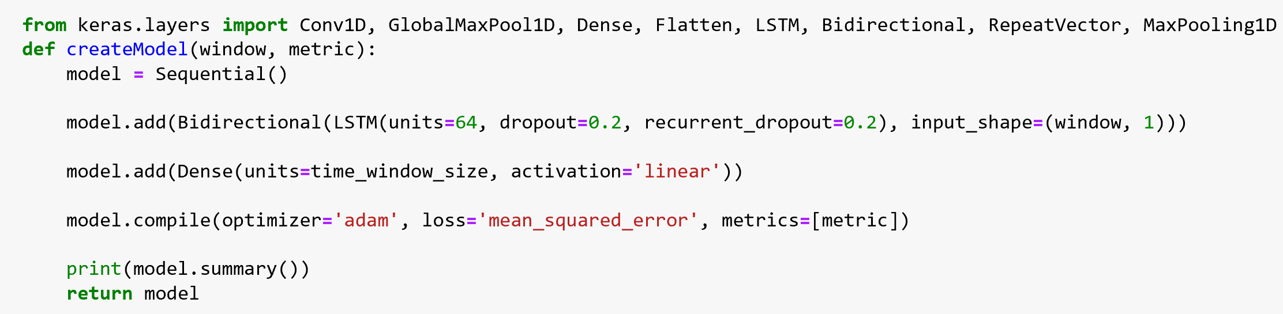
Bi-Directional LSTMs

Slide 39
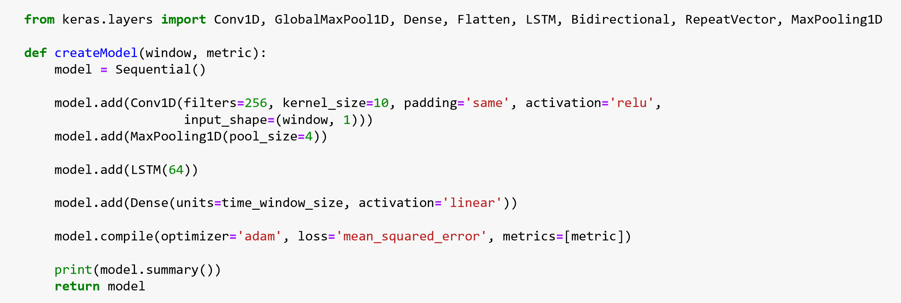
CNN + LSTMs

Slide 40
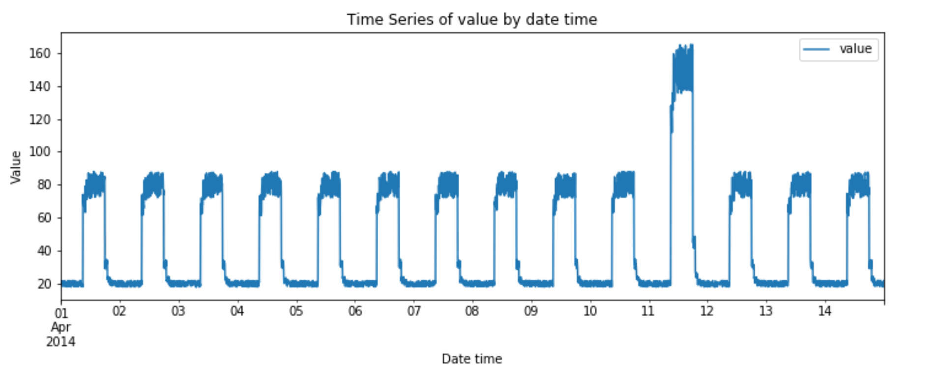
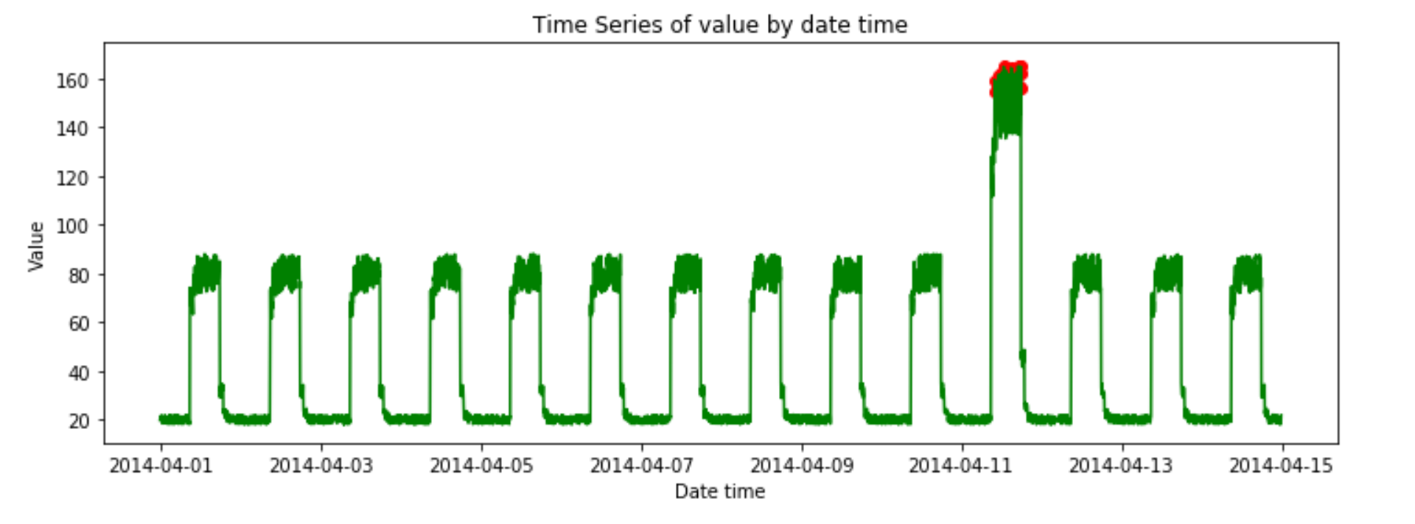
Examples

Slide 41
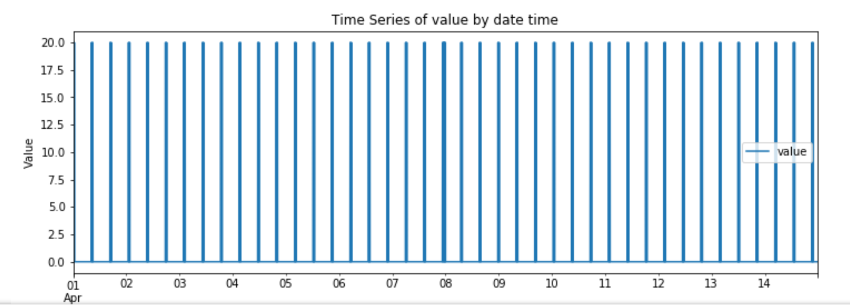
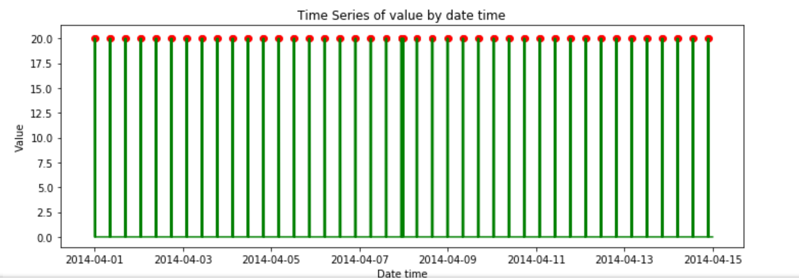
Examples

Slide 42
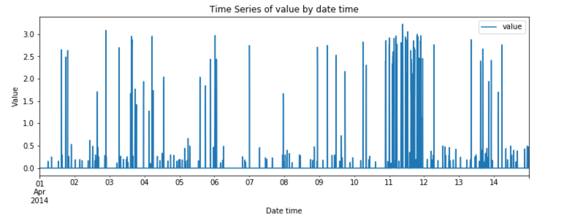
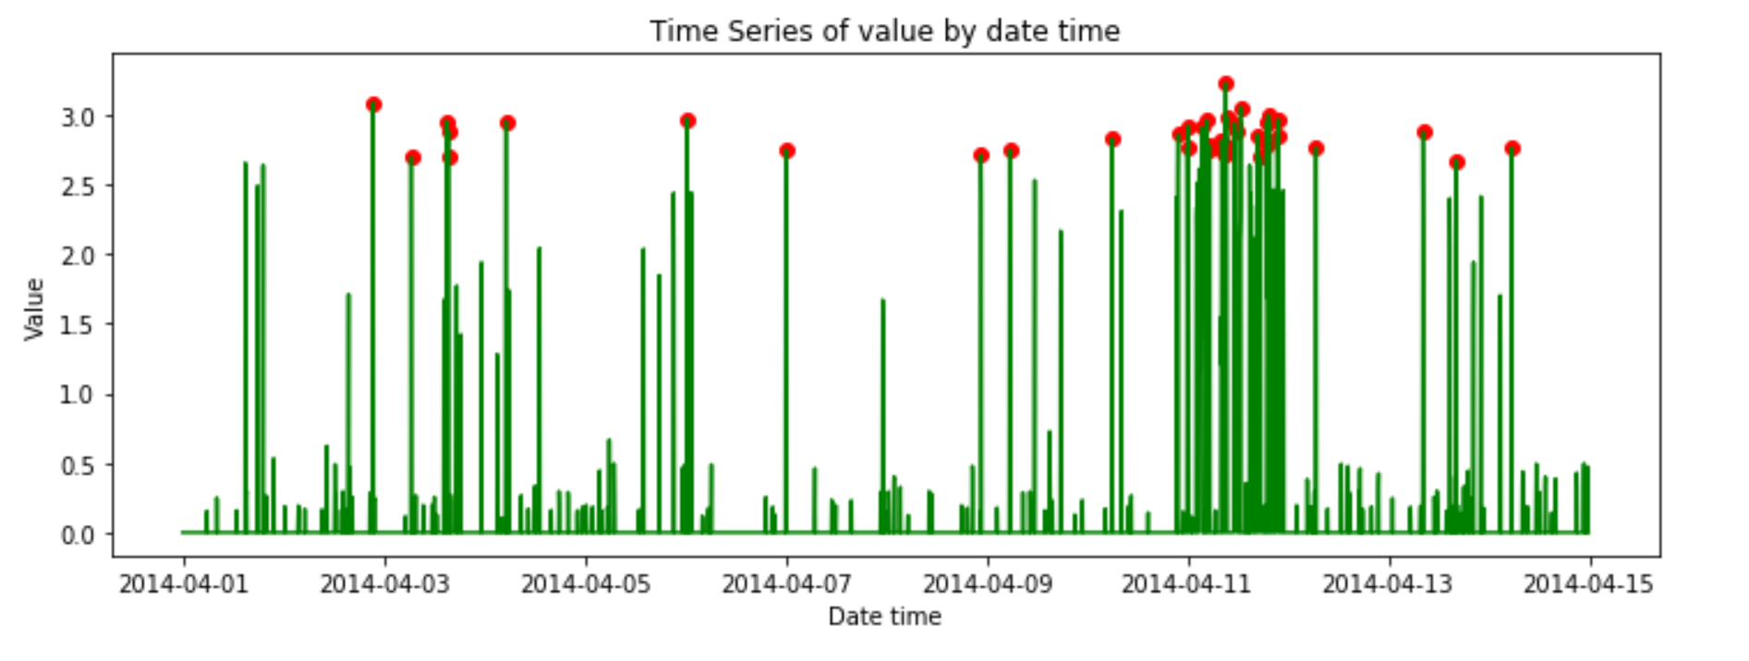
Examples

Slide 43
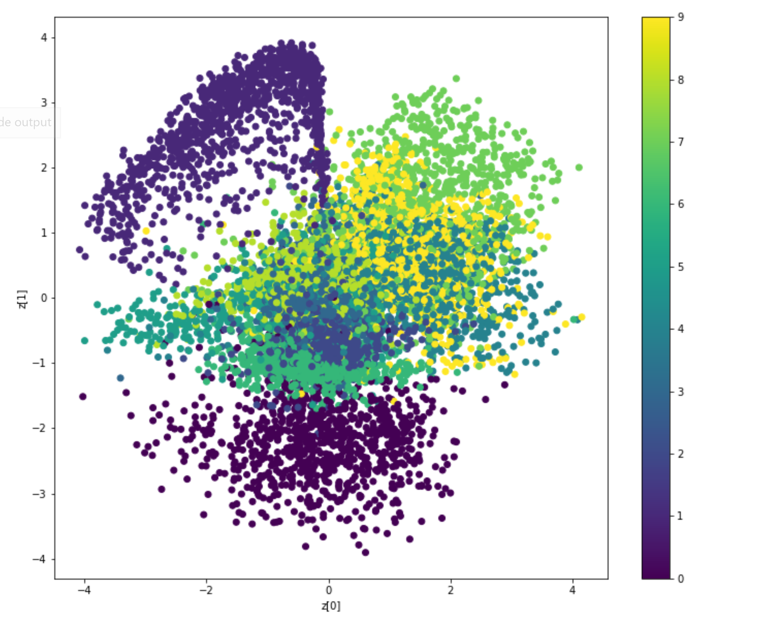
Examples

Slide 44
Key Observations
For univariate data , Autoencoders work best
For non time series data, Autoencoders work very well
For time series data, Autoencoders could be used however CNN based (LSTM or TCN) works better depending on the historical aspect (30 days/365 days/3 years etc)

Slide 45
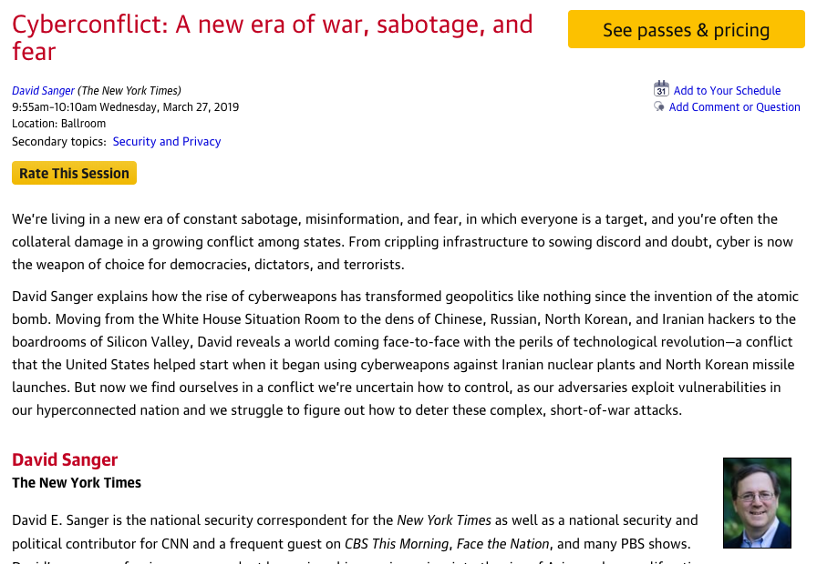

Rate today ’s session
Session page on conference website
O’Reilly Events App

Slide 46

Questions ?
Sridhar Alla : sid@bluewhale.one
Check out http://bluewhale.one
Syed Nasar: techtalk@nasars.com @techmazed
Cloudera Machine Learning Presentations: cloudera.com/ml

